Slide 1
Week 6th
Prepared by Dr Syed Khaldoon Khurshid

Slide 2
2.2: Machine Language
To apply the stored-program concept:
CPUs must recognize encoded instructions
Collection of instructions known as:
Instruction set, or
Machine language
Essential set of instructions quite small
Additional instructions do not increase capabilities

Slide 3
2.2: Instruction categories
Machine instructions classified into 3 categories:
(1) Data Transfer
move/copy data from one location to another
typical examples: LOAD, STORE
(2) Arithmetic/Logic
perform actual operations on data
typical examples: AND, OR, XOR, SHIFT, ROTATE
(3) Control
manipulate the execution of a program
typical examples: JUMP, HALT

Slide 4
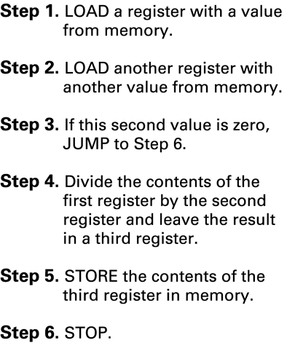
2.2: Example: dividing 2 values stored in memory

Slide 5
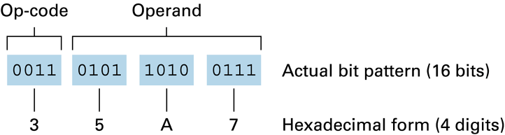
2.2: Composition of Machine Instructions
Machine instructions typically consist of 2 parts:
(1) Op-code (operation code)
indicates which operation (such as STORE, SHIFT, XOR) is requested by the instruction
(2) Operand
provides more information about the operation specified by the op-code (e.g. registers/memory cells to be used)

Slide 6
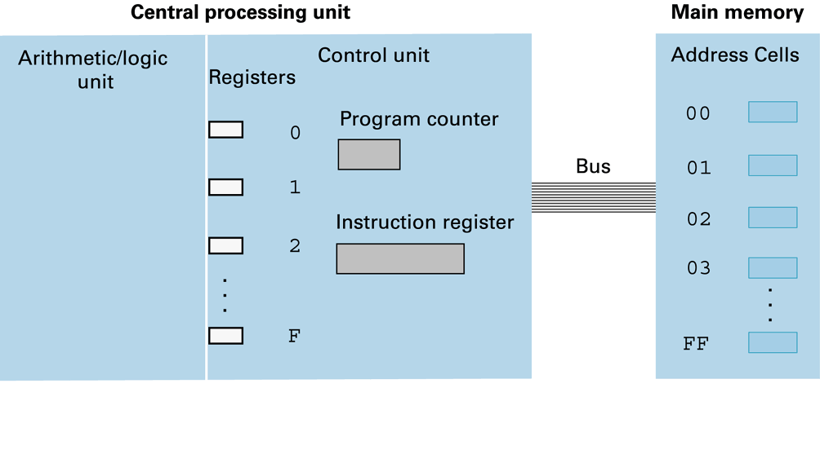
2.2: Simple Machine Architecture (Appendix C)
register holding address of next instruction
register holding current instruction

Slide 7
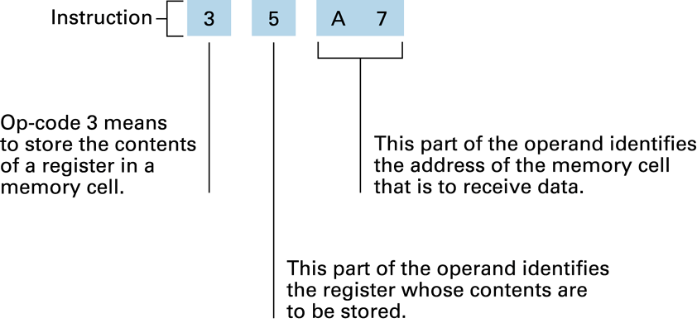
2.2: Example: decoding instruction 35A7 (App. C)

Slide 8
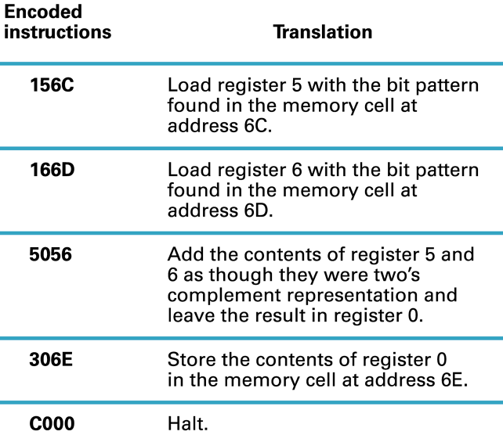
2.2: Adding two values stored in main memory

Slide 9
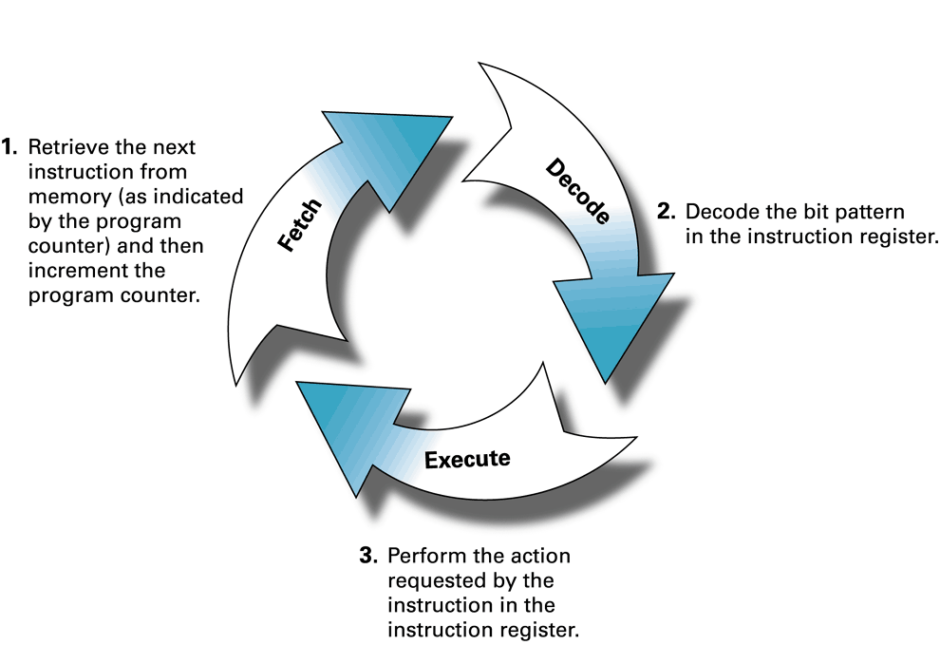
2.3: The Machine Cycle
(i.e.: break the operand field
into its proper components
based on the instruction’s
op-code)
(and store the instruction
in the instruction register)
Continually repeated by Control Unit until HALT
Special case: JUMP (i.e: may change program counter)

Slide 10
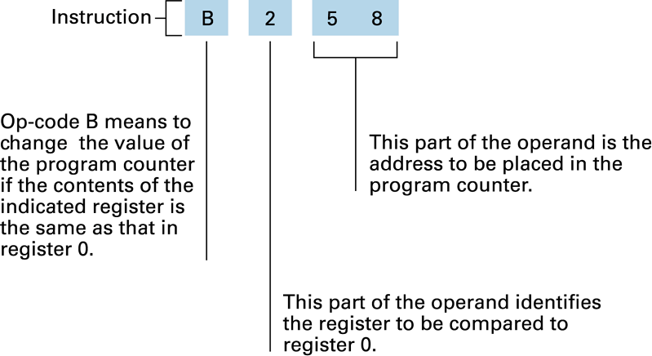
2.3: Decoding JUMP instruction B258
Translates as follows:
If contents registers 0 & 2 equal: place 58 in program counter
Otherwise: do nothing

Slide 11
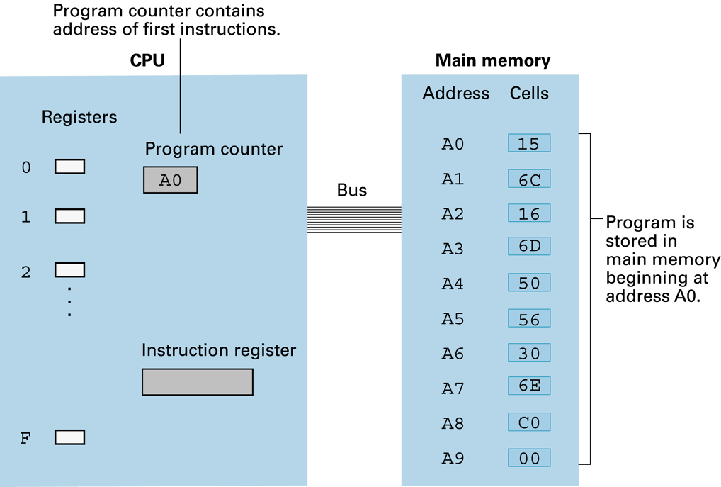
2.3: Example of Program Execution (Fetch)
A2
156C

Slide 12
2.4: Arithmetic/Logic Instructions
Boolean operations:
10011010
AND 11001001
10001000
10011010
OR 11001001
11011011
10011010
XOR 11001001
01010011
00001111
AND 10101010
00001010
AND used to force 0’s into certain positions:
00001111
OR 10101010
10101111
OR used to force 1’s into certain positions:
11111111
XOR 10101010
01010101
XOR used to form bit-string complement:

Slide 13
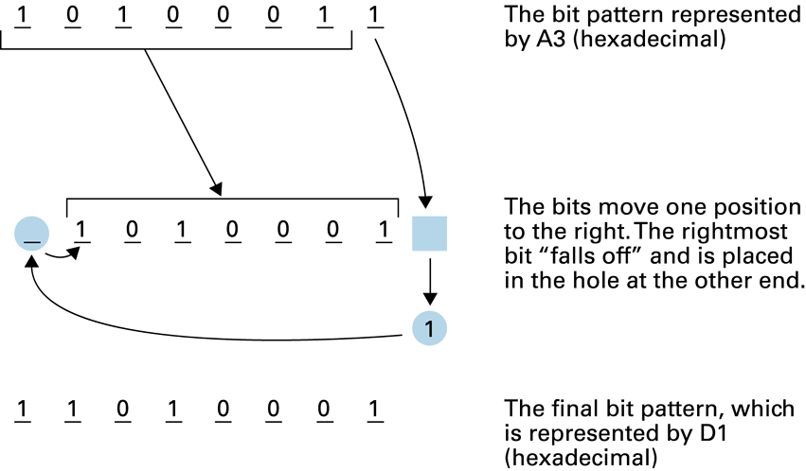
2.4: Arithmetic/Logic Instructions (cont’d)
Rotation and Shift:
Move bits within a register to left or right
e.g. for obtaining the mantissa in floating-point values
Example:

Slide 14
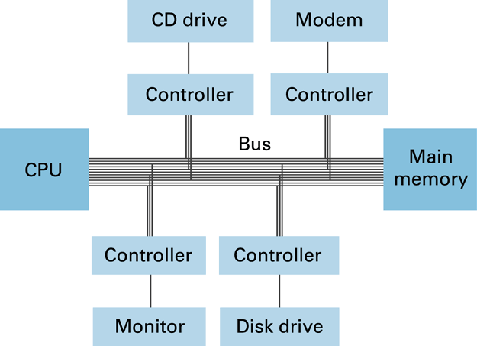
2.5: Communication with other devices
Handled through intermediary device: ‘controller’
CPU communicates with controllers in the same way that it communicates with main memory

Slide 15
2.6: ‘Von Neumann Architecture’- Problem
A problem of speed……!
electric pulses can go no faster than speed of light (approx. 30 cm per nanosecond)
For average machine:
fetch-decode-execute cycle takes several nano secs.
So: increasing speed becomes problem of scale
small, smaller, … stuck
In other words: there appears to be a speed limit!

Slide 16
2.6: ‘Von Neumann Architecture’- Alternatives (1)
One solution: Pipelining
allows steps in the machine cycle to overlap
during execution of one instruction, next is fetched
so: more than one instruction is ‘in the pipe’
Result: same speed - but higher throughput
Problems with JUMP instructions, of course…
pre-fetching becomes useless
Modern CPUs:
fetch & execute multiple instructions at a time

Slide 17
2.6: ‘Von Neumann Architecture’- Alternatives (2)
Other solution: (true) Parallel Processing
performing several tasks at the same time
needs multiple processing units
For example:
several complete PCs connected via fast network
each PC capable of independent execution
…

Slide 18
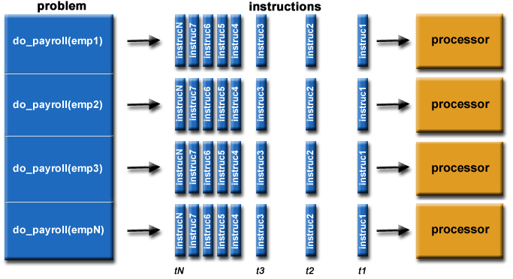
2.6: Parallel Processing: Example

Slide 19
Parallel Image Processing:
CPU 2
CPU 2
CPU 3
CPU 3
CPU 1
CPU 4
CPU 4
CPU 1
CPU 5
CPU 5

Slide 20
Chapter 2 - Data Manipulation: Conclusions
Today’s computers based on ‘Von Neumann’ Architecture
CPU connected to main memory via bus
Both program & data stored in main memory
Program execution based on Machine Cycle
fetch - decode - execute
Peripheral devices connected via controllers
Alternatives to ‘Von Neumann’ Architecture:
based on pipelining / true parallel processing
Concurrency

Slide 21
PARALLELISM
Prepared by Dr Syed Khaldoon Khurshid
Powered by Brilliant Application

Slide 22
Taking advantage of parallelism is a good computer science problem-solving technique to explore, because it is both fundamentally simple and extremely powerful. Simply put, parallelism is just trying to solve problems faster by doing multiple things at the same time.

Slide 23

You'll explore parallelism in the context of Pierre and his patisserie.

Slide 24
There’s lots of parallelism in a bakery. Multiple tasks can happen at once, and multiple people can combine forces to make single tasks faster.
By the end of this exploration, you’ll understand how the underlying concept of parallelism applies to computer systems in the real world. You’ll learn about:
Amdahl's law, an important piece of common-sense mathematics for computer scientists,
Pipelining, a form of parallelism that enables advanced computer graphics, and
Concurrency, and how it's managed to let the many apps on your phone run at the same time.

Slide 25

Pierre arrives at his bakery in the morning, with the goal of preparing 200 fresh pastries as quickly as possible.

Slide 26
He takes the dough he prepared the night before out of the refrigerator, and looks at his recipe:
Cut the dough into triangles (2 minutes for all 200).
Spread filling onto triangles (4 minutes for all 200).
Roll filled triangles into crescents (10 minutes for all 200).
Heat the oven to 400° F (oven takes 1 minute to turn on and then 16 minutes to heat up).
Place pastries in the fully heated oven for 20 minutes.
Remove the pastries from the oven and pipe chocolate on top (4 minutes for all 200).
After piping, let the pastries cool for 10 minutes before serving.

Slide 27
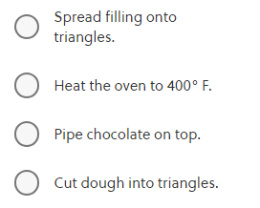
What should Pierre's first step be?

Slide 28
Correct answer: Heat the oven to 400° F.
Only two of the options make much sense as a first step: cutting the dough into triangles and heating the oven. You can't pipe chocolate or spread filling onto cut triangles when the pastry dough hasn't been cut!
To see why he should heat the oven first, notice that Pierre will need 2 minutes to cut the dough into triangles, 4 minutes to spread filling onto the triangles, and 10 minutes to roll the filled triangles into crescents. This is a total of 16 minutes, the same amount of time it takes for the oven to heat up.
Therefore, the first thing Pierre should do is turn the oven on. Then, he'll have pastries in the oven 17 minutes after he starts. Any delay in heating the oven means that it'll take longer to get the pastries finished.

Slide 29
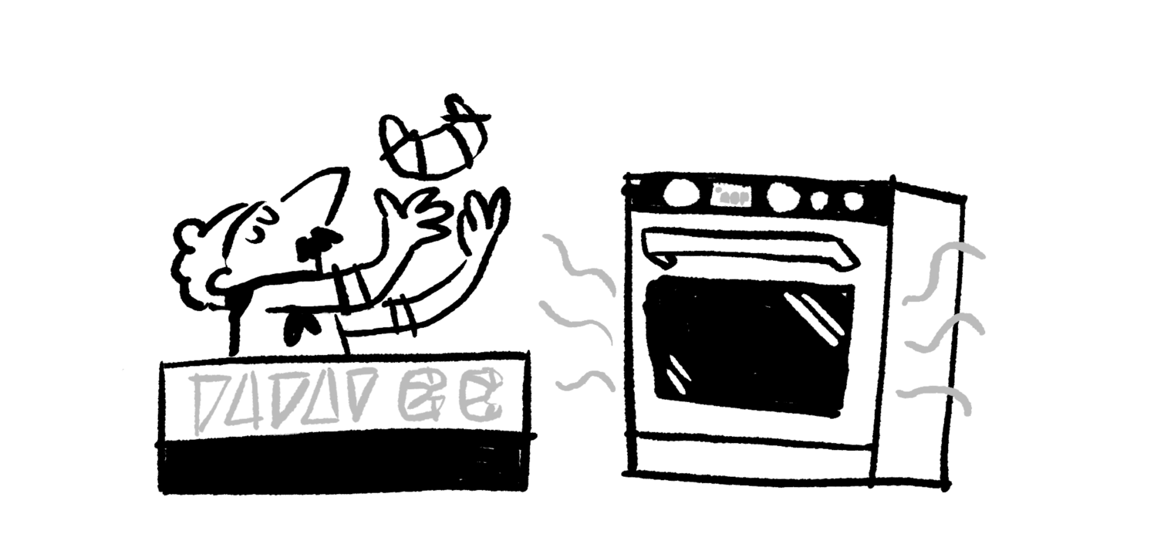
Pierre's kitchen can do two things at once: the oven can warm up while Pierre prepares his pastries.

Slide 30
This phenomenon comes up frequently in our daily lives, and it also comes up in computer science—sometimes in surprising ways!
Every modern computer is incredibly fast at performing calculations. It's so fast that reading a file from a hard drive takes ages by comparison: a computer can perform tens of thousands of calculations in the time it takes to request information from its own hard drive and get that information back. Depending on the computer, it might be able to perform millions of calculations.
Computer systems are designed to do useful work while they're waiting for the hard drive to access a file, just as Pierre works to prep his pastries while the oven warms up.

Slide 31
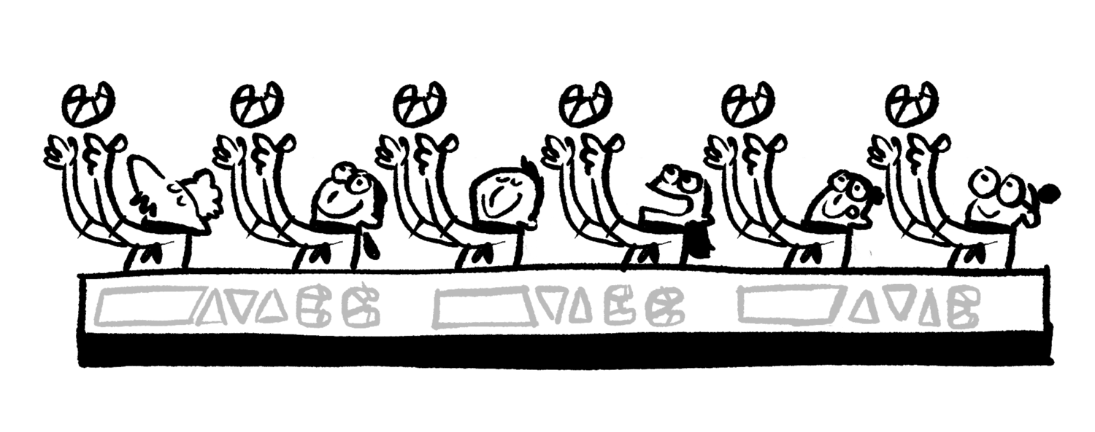
When Pierre brings in an assistant, he's practicing another form of parallelism. One person can cut a sheet of pastry dough in 30 seconds, and two people can split up the work and cut two sheets of pastry dough in 30 seconds, getting twice as much done!

Slide 32
When multiple workers can split up a problem without adding in much extra coordination overhead, computer scientists sometimes call the problem
embarrassingly parallel.
An embarrassingly parallel task can be considered a trivial case - little or no manipulation is needed to separate the problem into a number of parallel tasks.
This is often the case where there is little or no dependency or need for communication between those parallel tasks, or for results between them.
https://en.wikipedia.org/wiki/Embarrassingly_parallel#:~:text=From%20Wikipedia%2C%20the%20free%20encyclopedia,delightfully%20parallel%20or%20pleasingly%20parallel).

Slide 33
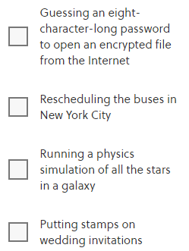
Which of these problems are embarrassingly parallel? (Select all that apply.)

Slide 34
Correct answer: Guessing an eight-character-long password to open an encrypted file from the Internet, and Putting stamps on wedding invitations
It's easy to split up the invitations so that multiple people can share the work of adding stamps.
If you share the password-protected file, it's easy to divide up the list of all possible eight-character-long passwords so that two computers, a thousand computers, or a million computers can share the work. If you've ever had your bank account locked because there were too many incorrect guesses, that was the bank trying to prevent multiple people (or computers) from working together to guess your password!

Slide 35
Bus schedules are all dependent on one another for fast transfers, and many other entities, including schools, trains, and hospitals, make decisions based on bus schedules. Therefore, bus scheduling is a problem with an enormous and necessary amount of coordination overhead. It is not embarrassingly parallel at all.
Physics simulations are interesting. Because every star in the galaxy has a gravitational effect on every other star in the galaxy, this is not considered an embarrassingly parallel problem. However, using multiple computers in parallel to perform physics simulations is an incredibly important part of modern cosmology. Physicists and computer scientists have put decades of work into figuring out how to minimize coordination overhead to make physics simulations as fast and parallel as possible.

Slide 36
Once Pierre's oven is up and running, he doesn't have to worry about reheating it anymore. His oven can fit 200 pastries at once. Here's his recipe again:
Cut the dough into triangles (2 minutes for all 200).
Spread filling onto triangles (4 minutes for all 200).
Roll filled triangles into crescents (10 minutes for all 200).
Place pastries in the oven for 20 minutes.
Remove the pastries from the oven and pipe chocolate on top (4 minutes for all 200).
After piping, let the pastries cool for 10 minutes before serving.
If Pierre is working alone with a preheated oven, it takes him 50 minutes to completely bake 200 pastries.

Slide 37


Slide 38

If Pierre is working with one assistant who can help with the cutting, spreading, rolling, and piping steps at the same speed as Pierre, and the oven is preheated, how many minutes will it take before he has ready-to-serve pastries?

Slide 39
Correct answer: 40
There's no way to make the 20 minutes of cooking or 10 minutes of cooling go faster. However, the remaining 20 minutes of work—cutting, spreading, rolling, and piping—can be done in parallel by two bakers, so a single assistant would help Pierre get that work done in 10 minutes.

Slide 40
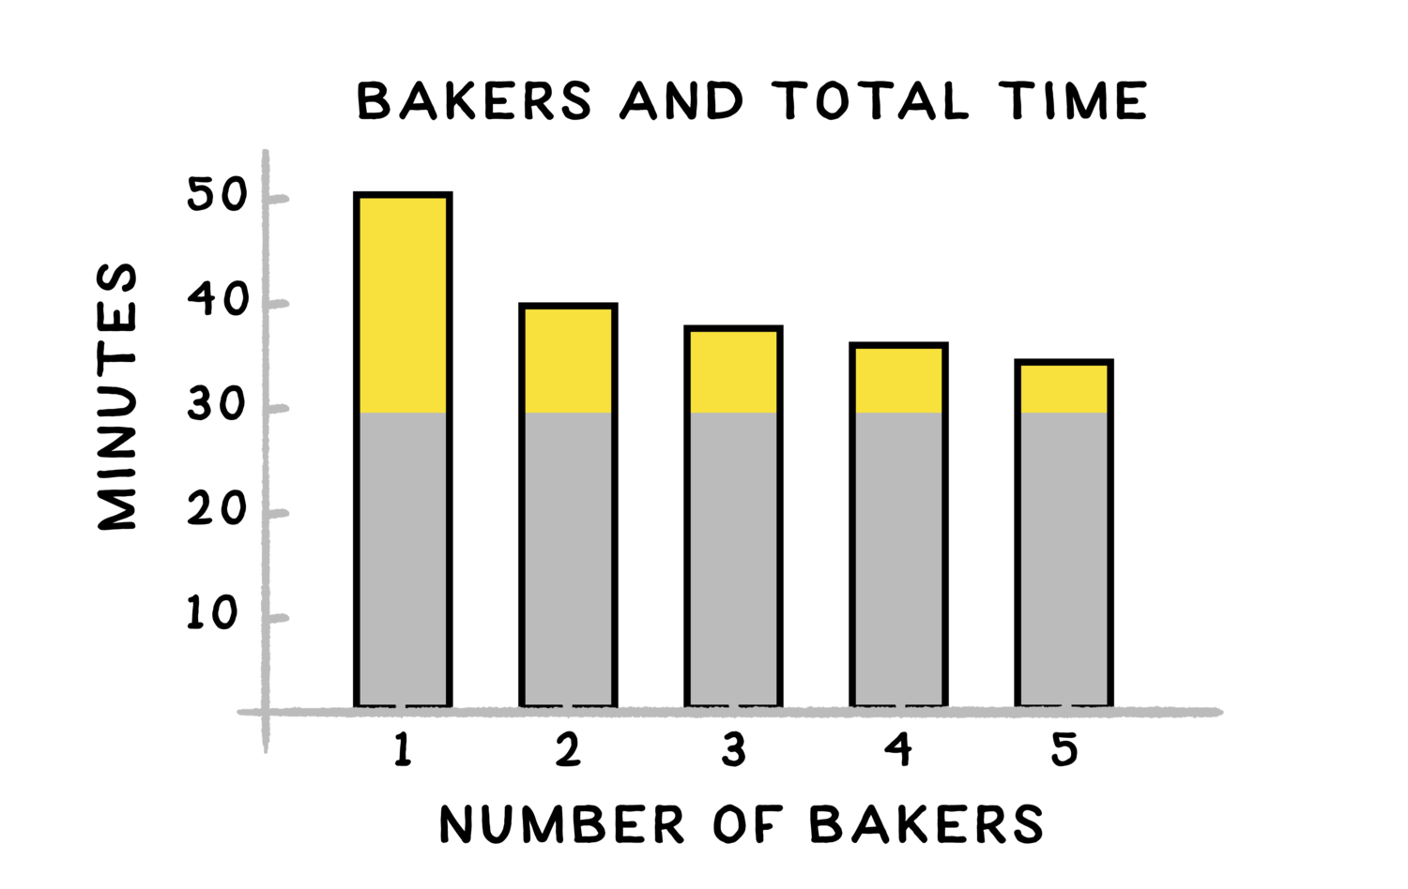
Most of the time Pierre needs to make his pastries is spent in the baking and cooling phases. The chart below shows how more assistants don't end up helping him make pastries much faster. Only 20 minutes of work can be split up—that's the yellow part of the bars. The other 30 minutes of work can't be done in parallel—that's the gray part.

Slide 41
Everyone from computer scientists to bakers and architects can fall into the trap of thinking that they can speed something up by throwing more workers into the mix. But that isn't true. When you think about parallel and non-parallel tasks, it should be obvious that adding more workers will only make you faster at the parts of a task that can be done in parallel.
This common-sense observation is important enough in computer science that it has a name, Amdahl's law, after Gene Amdahl who wrote a paper about it in 1967.

Slide 42
Pierre makes pastries 10 minutes faster by hiring one assistant. You can see this on the graph above, where 50 minutes required for Pierre alone is reduced to 40 minutes when Pierre is working with one assistant.
In a different bakery, Hans and his one assistant work together, so there are two bakers and baking takes 40 minutes.

Slide 43

Hans is thinking about buying a fan to decrease the non-parallelizable cooling time from 10 minutes to 5 minutes. If Pierre and his one assistant wanted to achieve the same 5-minute gain by hiring more people, how many additional assistants would they need to hire?

Slide 44
Correct answer: Two
Hiring two new assistants doubles the total number of bakers and doubles their working speed. Doubling their working speed only saves them five minutes.
Even though the fan only reduces the non-parallel food preparation time from 30 minutes to 25 minutes, a roughly 17% reduction, it gives the same overall speedup.

Slide 45
You saw in the previous example that, even with a preheated oven, it took Pierre 50 minutes to make pastries, and 30 minutes of that time can't be parallelized. Does this mean that Pierre's patisserie is limited to producing 200 pastries every 50 minutes (4 pastries per minute) if Pierre works alone, or at most 200 pastries every 30 minutes (~6.7 pastries per minute) no matter how many assistants he hires?
No! If Pierre is concerned with his overall production rate, he can do better than 6.7 pastries per minute, and he can do it without any assistant.

Slide 46
The solution may be familiar to anyone who has ever made lots of cookies at once. Pierre needs to prep his current batch of 200 pastries while the previous batch of 200 is cooking. If he times it so that his prep is done when the previous batch finishes cooking, he can put the current batch in the oven, pipe chocolate on the previous batch and leave it to cool, and then immediately start prepping the next batch of pastries.

Slide 47
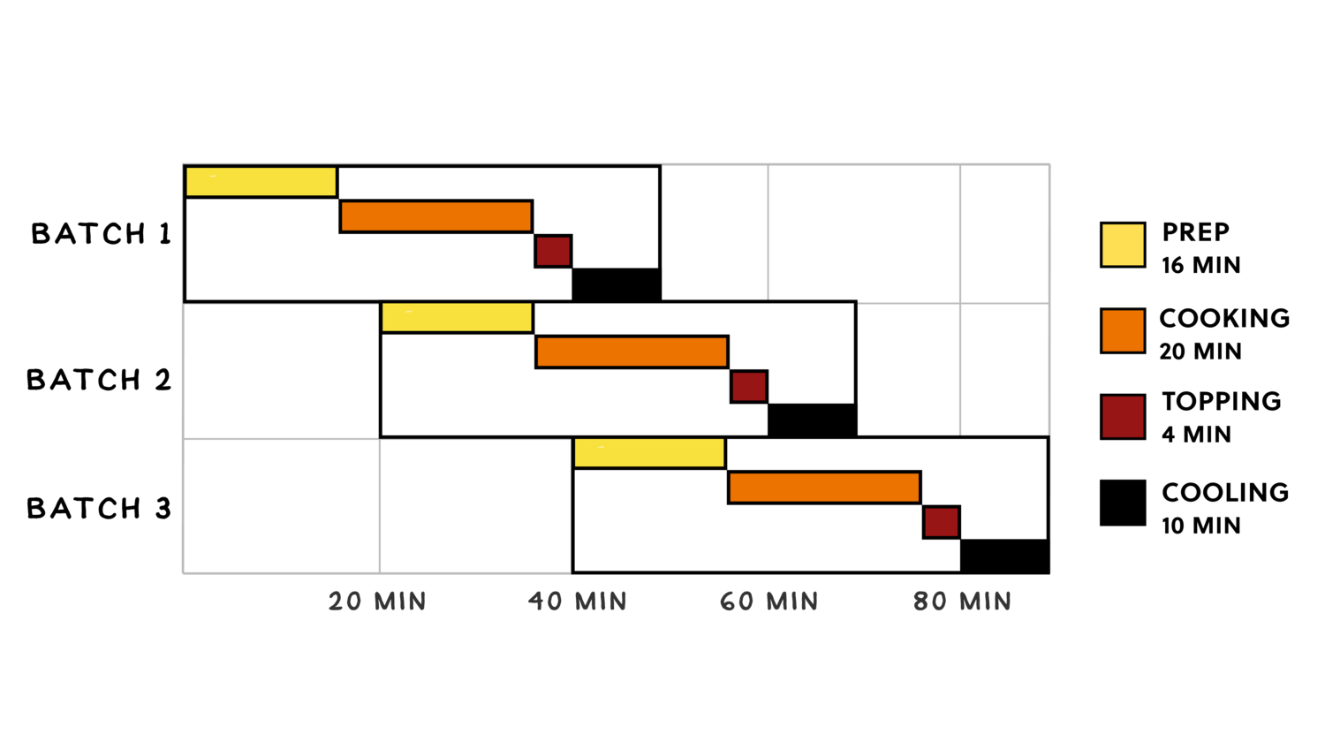

Slide 48
This is another form of parallelism, called pipelining. By working on different batches of pastries in parallel, the plan above ensures that both the oven and Pierre are always working: either on the previous, current, or next batch of pastries.
It takes an hour for Pierre's operation to get up and running at full speed, but after that, the schedule above shows that Pierre is able to begin a new batch of 200 pastries every 20 minutes. What is his average rate of pastry production per minute?

Slide 49

Once Pierre has his operation running, it's clear to see on the chart he is starting a batch of pastries every 20 minutes: on the 20 minute mark, the 60 minute mark, the 80 minute mark, and so on.
The schedule doesn't have any bottlenecks, so Pierre will also complete 200 pastries every 20 minutes.
Therefore, Pierre will be producing 10 pastries per minute with this approach.

Slide 50
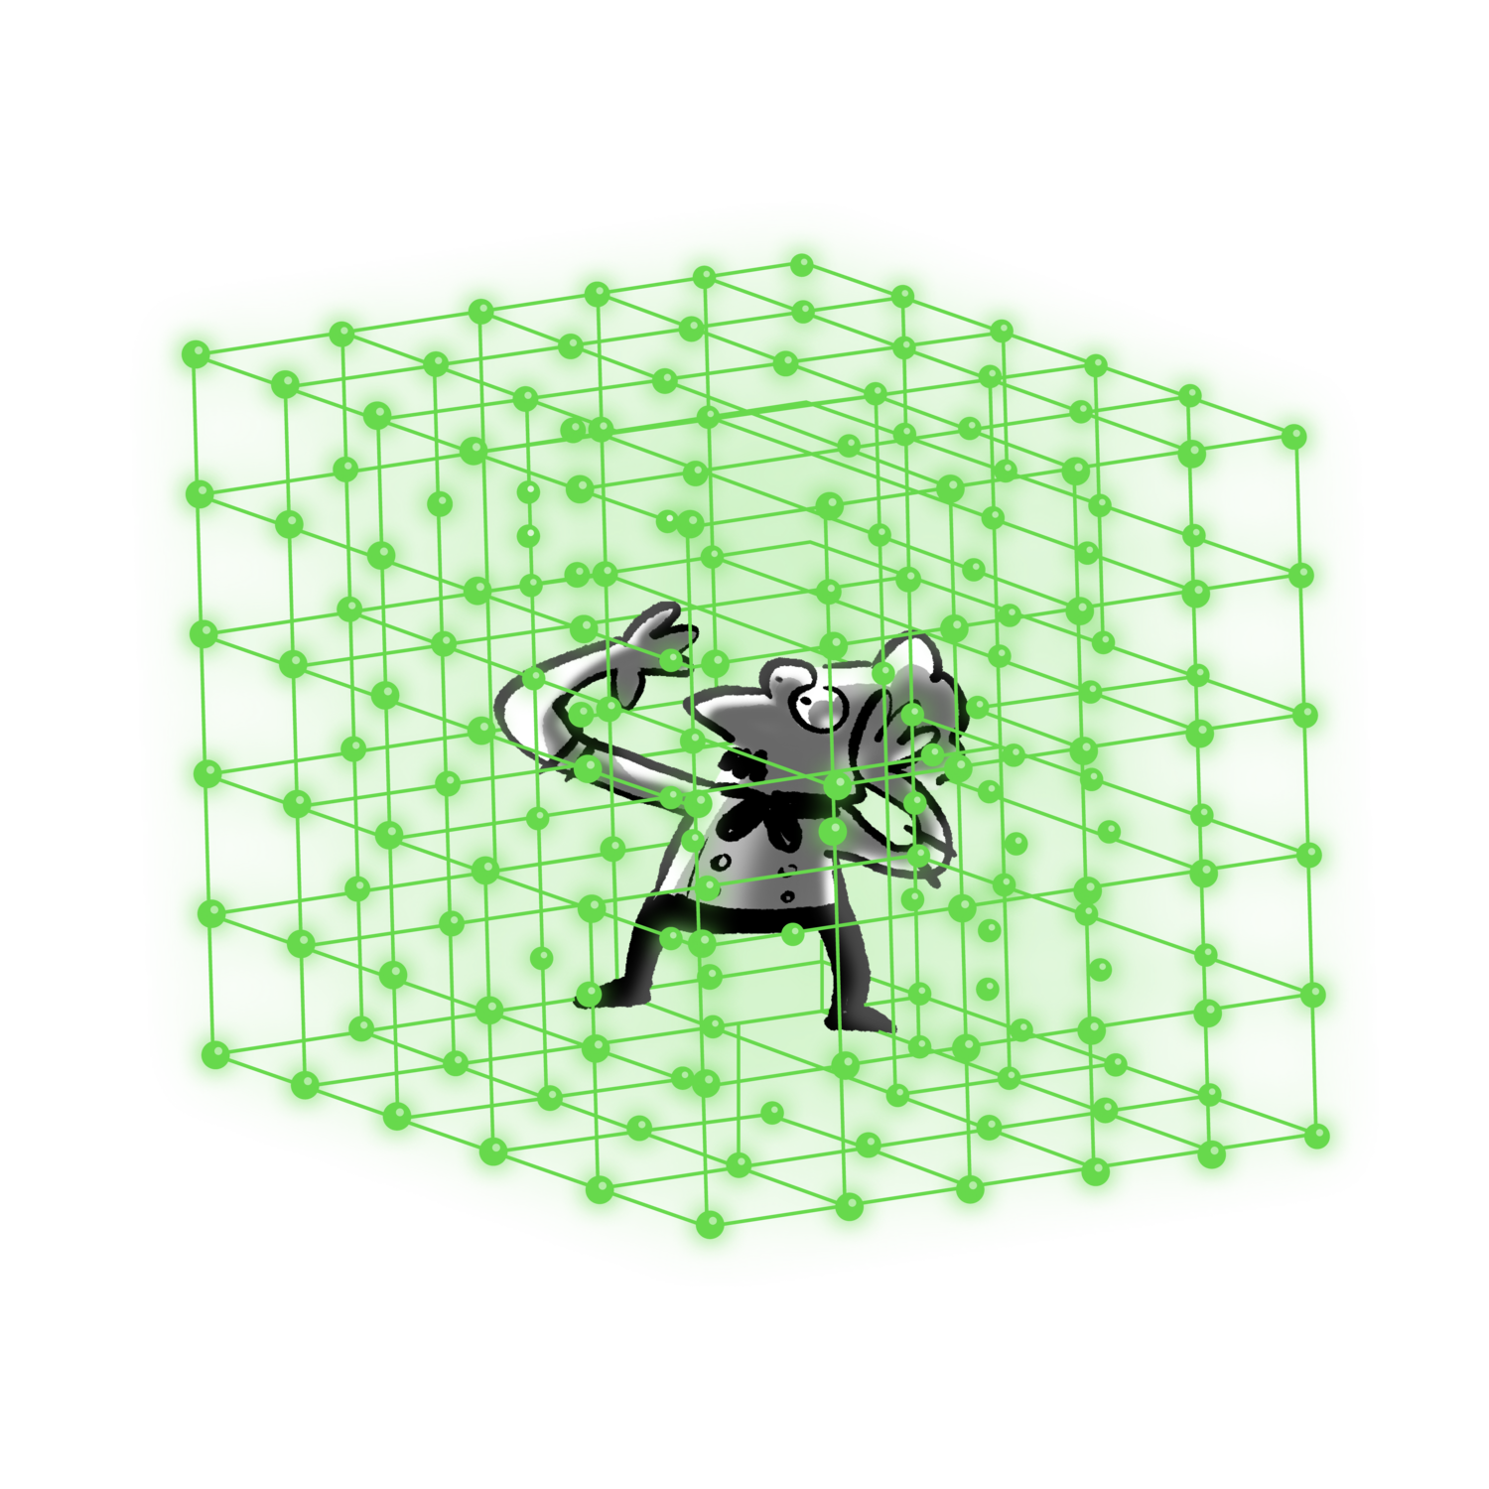
Pipelining is a critical form of parallelism in the design of computer systems. 3D computer graphics are a place where pipelining has been important for a long time.

Slide 51
A computer has to do a predictable amount of work to display a three-dimensional scene in a computer game. The computer has to determine which parts of which objects are visible, figure out how those objects are lit, and translate the visible objects into individual pixels to be displayed. It's possible for the computer to anticipate how long each step will take ahead of time.
This predictable flow makes computer graphics good for pipelining: while your computer is figuring out how to display pixels for the current scene, it is also figuring out how to light a scene it will show in the next fraction of a second, and is also figuring out which objects are visible in a scene that is a few fractions of a second further away from being shown.

Slide 52
Pipelining is so important that a computer's hardware will make guesses about what it will be asked to do next in order to keep all the parts of a pipeline working. This is called speculative execution.
Imagine Pierre having a spare moment in his kitchen and prepping bread dough or pastry dough before knowing whether he will get an order for bread or pastries. It won't slow him down if he guesses wrong (he might just waste some dough), but guessing right will help him finish the next order faster.

Slide 53
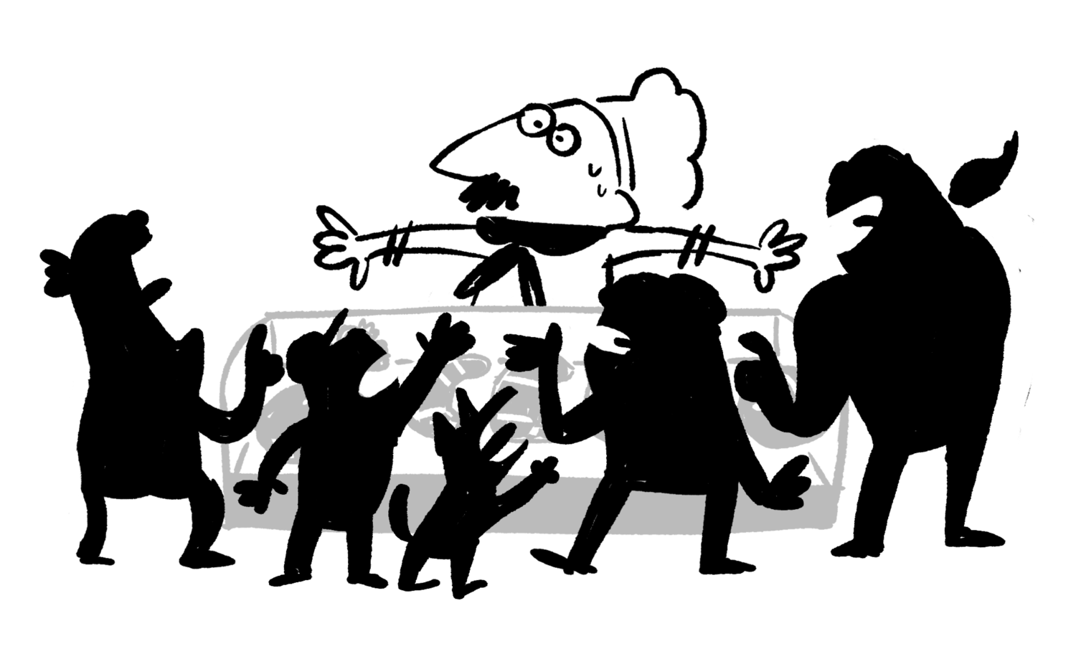
If you leave the kitchen and walk into Pierre's storefront, you'll see a concept closely related to parallelism:

Slide 54
From a certain perspective, there is parallelism at work in the busy crowd. All the individuals who want to buy Pierre's pastries are independently working on accomplishing their goals for the day, in parallel.
However, this situation introduces a new wrinkle: there is conflict, because each person in the bakery needs brief but exclusive access to the cashier in order to meet their goals.

Slide 55
Concurrency is the name for situations where multiple agents each want a turn at having exclusive access to the same resource (like the cashier). It sometimes shows up in similar places as parallelism, but concurrency occurs when there's no way to plan in advance for the order in which things will happen.
Pierre can plan a schedule for himself and his assistants. However, he and his customers don't have any way of anticipating who else will show up wanting pastries.

Slide 56
In your computer or phone right now, multiple independent programs are trying to access the processor to do their computations, trying to access the networking hardware that communicates with the Internet, and trying to display content on the screen. It is the task of your computer's operating system to help these multiple programs manage concurrent access to the resources they all need.

Slide 57
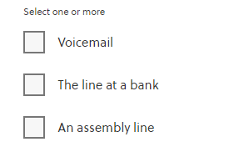
Which of these are systems that help manage concurrency in the real world? (Select all that apply.)

Slide 58
Correct answer: Voicemail, and The line at a bank
A traffic light and the line at a bank are both straightforward tools for managing concurrency in the real world: when many cars or customers want to cross an intersection or talk to a bank teller, the system determines who gets to go and who has to wait.
Voicemail is less obviously a tool for managing concurrency. If the person you're trying to contact is already on the phone, you will be sent to voicemail so that they can respond later. If you have ever been put on hold until a customer service representative is able to take your call, you've encountered a different tool for dealing with the same concurrency problem.

Slide 59
Assembly lines are excellent real-world examples of pipeline parallelism. Multiple parts of an object are built at once, in a well-defined order, and the assembly line keeps everyone busy by working on different parts of different tasks at the same time. That makes an assembly line a good example of parallelism, but not of concurrency.

Slide 60


One way of dealing with concurrency that is commonly used in bakeries and food joints is to have a machine that distributes numbers.

Slide 61
The cashier can then control which customer is currently able to access their limited resource.
This is fairly straightforward and, in fact, computer systems use the same intuition for managing concurrency between different programs that need to coordinate access to some resource.
One method for doing so, popularized by Leslie Lamport, is even called the bakery algorithm!

Slide 62
Conclusion
The most common kind of parallelism is splitting up a problem and assigning it to different workers.
If you can't use parallelism on every part of a problem, adding more and more workers may not help you very much.
When you need to work on different problems at the same time, it can be useful to use pipeline parallelism.
When different tasks need exclusive access to a single shared resource in an unpredictable order, you are dealing with concurrency.
Concurrency and parallelism show up in many of the same places, but they are different ideas.

Slide 63
Any Questions?
Notes:
Reading
Richard Fayman -> Biography -> Interesting to read-> Physics lectures
Algorithms are eating our work-> Ted Talk.
Computer Limitations -> Travel’s sale man problem.
Contents are books, Grading -> not required
Less Text should be replaced by Images.
Slides makes students passive.

